Slide 1
DATA SCIENCE class xII: ensemble

Slide 2
Interview question
Q: What is dimensionality reduction?

Slide 3
Interview question
Q: What is dimensionality reduction?
A: A set of techniques for reducing the size (in terms of features,
records, and/or bytes) of the dataset under examination.
In general, the idea is to regard the dataset as a matrix and to decompose the matrix into simpler, meaningful pieces.

Slide 4


reducing dimensionality

Slide 5
Interview question
Q: What are the motivations for dimensionality reduction?

Slide 6
Interview question
Q: What are the motivations for dimensionality reduction?
The number of features in our dataset can be difficult to manage, or even misleading (eg, if the relationships are actually simpler than they appear).

Slide 7
Interview question
For example, suppose we have a dataset with some features that are related to each other.

Slide 8
Interview question
For example, suppose we have a dataset with some features that are related to each other.
Ideally, we would like to eliminate this redundancy and consolidate the number of variables we’re looking at.

Slide 9
Interview question
For example, suppose we have a dataset with some features that are related to each other.
Ideally, we would like to eliminate this redundancy and consolidate the number of variables we’re looking at.
If these relationships are linear, then we can use well-established techniques like PCA/SVD.

Slide 10
Curse of dimensionality
The complexity that comes with a large number of features is due in part to the curse of dimensionality.

Slide 11
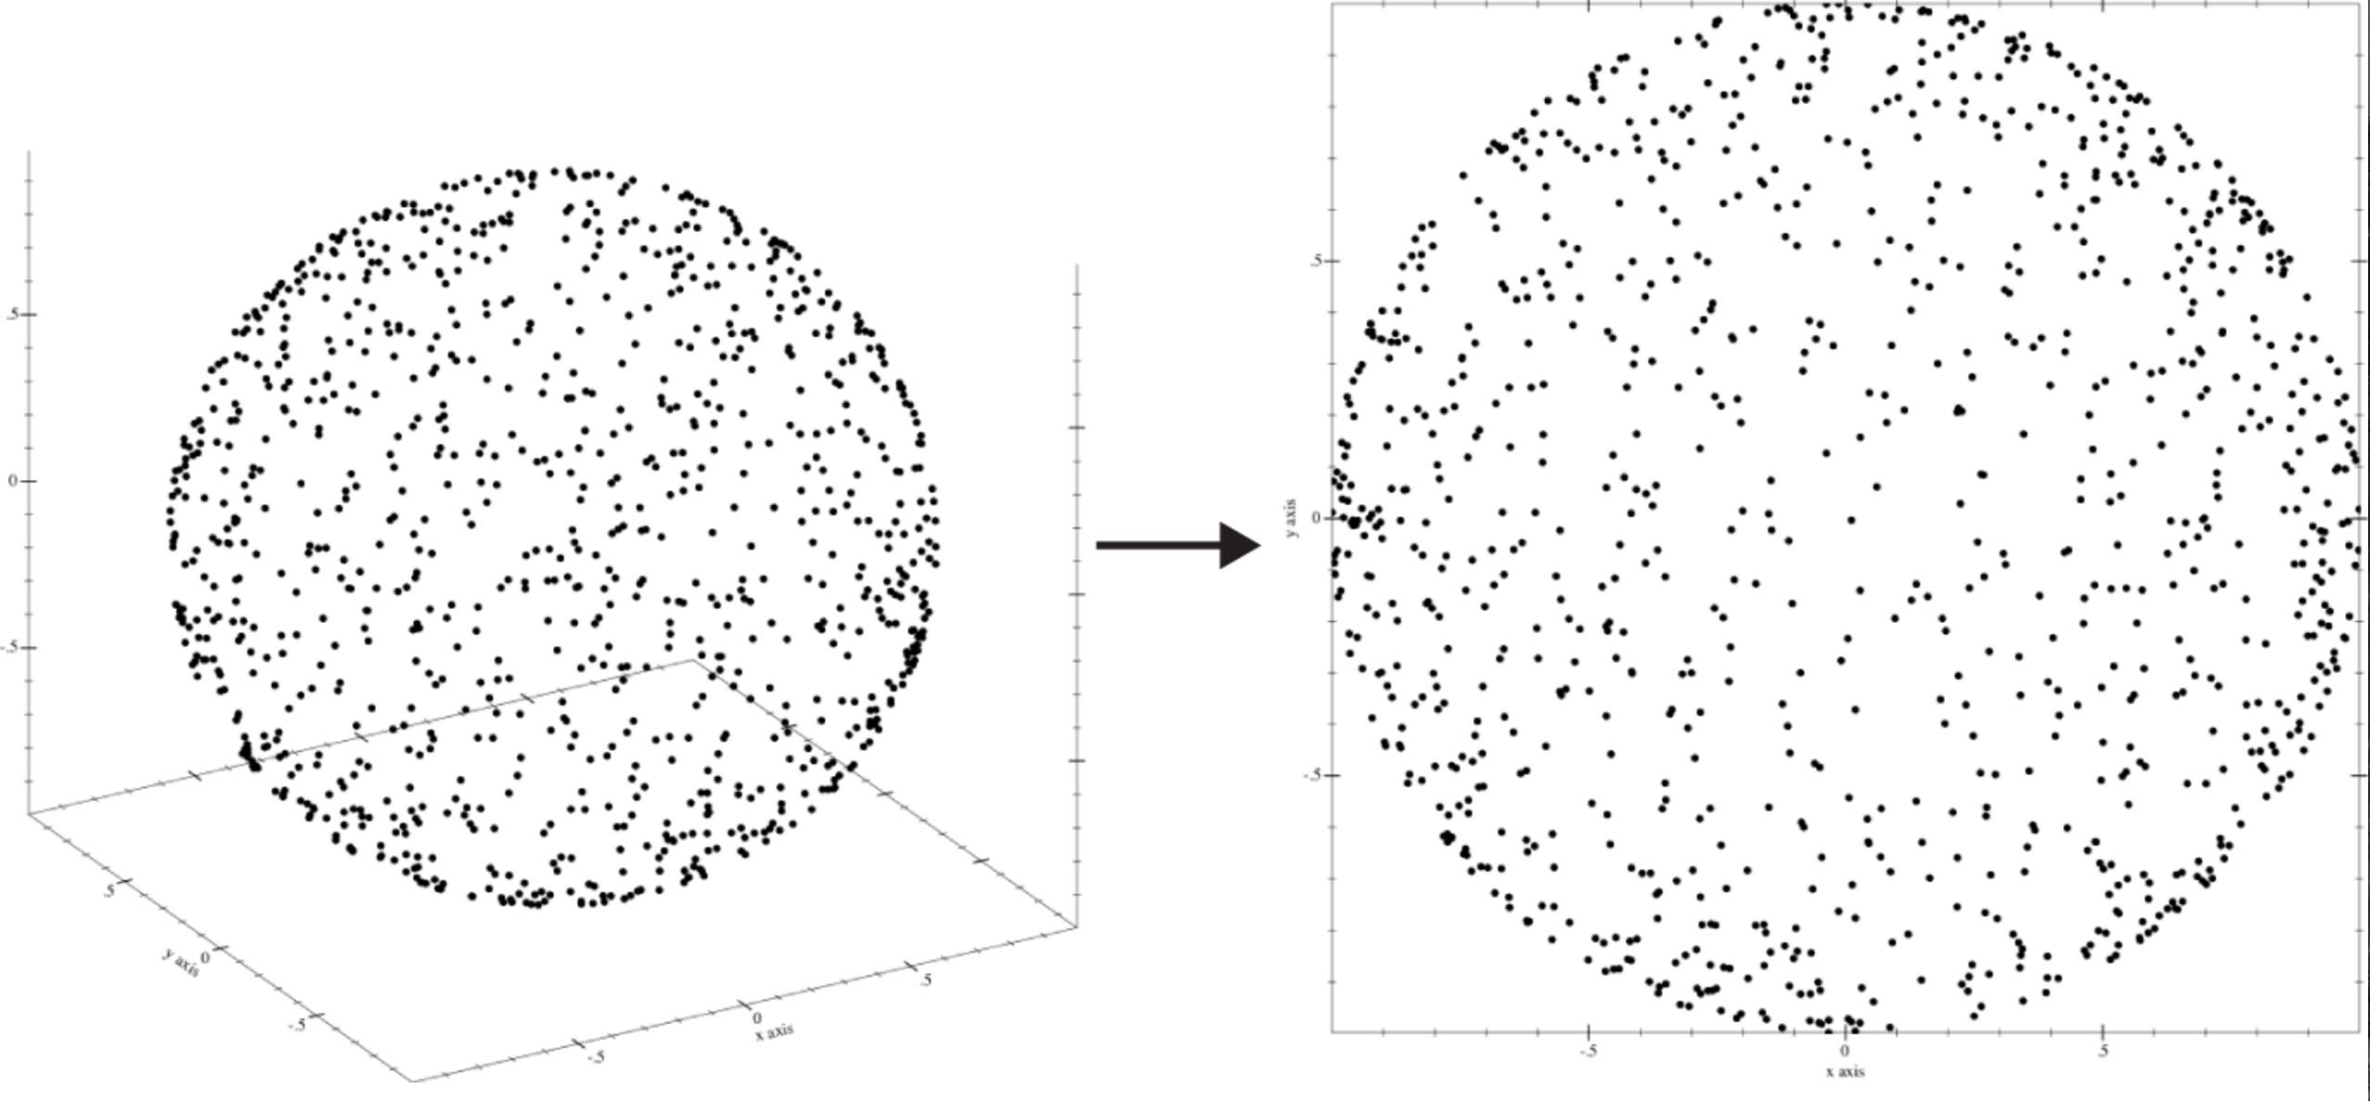
Curse of dimensionality
The complexity that comes with a large number of features is due in part to the curse of dimensionality.

Slide 12
Curse of dimensionality
Another way of characterizing this is to say that high-dimensional spaces are inherently sparse.
ex: A high-dimensional orange contains most of its volume in the rind!
ex: A high-dimensional hypercube contains most of its volume in the corners!

Slide 13
Curse of dimensionality
In either case, most of the points in the space are “far” from the center.
This illustrates the fact that local methods will break down in these circumstances (eg, in order to collect enough neighbors for a given point, you need to expand the radius of the neighborhood so far that locality is not preserved).

Slide 14
Curse of dimensionality
High dimensional spaces can be problematic
Many algorithms assume that data isn’t sparse
The more dimensions you have, the more sparse the data is
This can result in solutions that aren’t statistically significant

Slide 15
Dimensionality reduction
By performing dimensionality reduction you believe that data can be represented by fewer dimensions. That the intrinsic dimension is a lot lower.

Slide 16
Dimensionality reduction
If we have a matrix X which is n x d, can we represent it as n x k where k < d and note lose information?

Slide 17
Dimensionality reduction
Q: How is dimensionality reduction performed?
A: There are two approaches: feature selection and feature extraction.
feature selection – selecting a subset of features using an external criterion (filter) or the learning algo accuracy itself (wrapper)
feature extraction – mapping the features to a lower dimensional space

Slide 18
Dimensionality reduction ex-eigenfaces
Introduced initially by Sirovich and Kirby
Suspected can represent a human with fewer dimensions
Were able to reduce the data points from 2¹⁴ to 40 with 3% error
http://www.face-rec.org/interesting-papers/General/ld.pdf

Slide 19
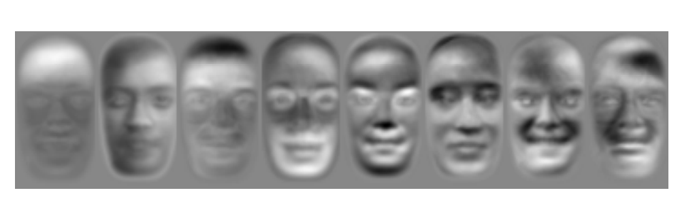
Dimensionality reduction-eigenfaces
http://www.cs.columbia.edu/~jebara/4772/papers/TR2000-42.pdf

Slide 20
DATA SCIENCE class xII: ensemble

Slide 21
Principal component analysis
Principal component analysis (PCA) is a dimension reduction technique that can be used on a matrix of any dimension

Slide 22
Principal component analysis
Principal component analysis is a dimension reduction technique that can be used on a matrix of any dimensions.
This procedure produces a new basis, each of whose components retain as much variance from the original data as possible.

Slide 23
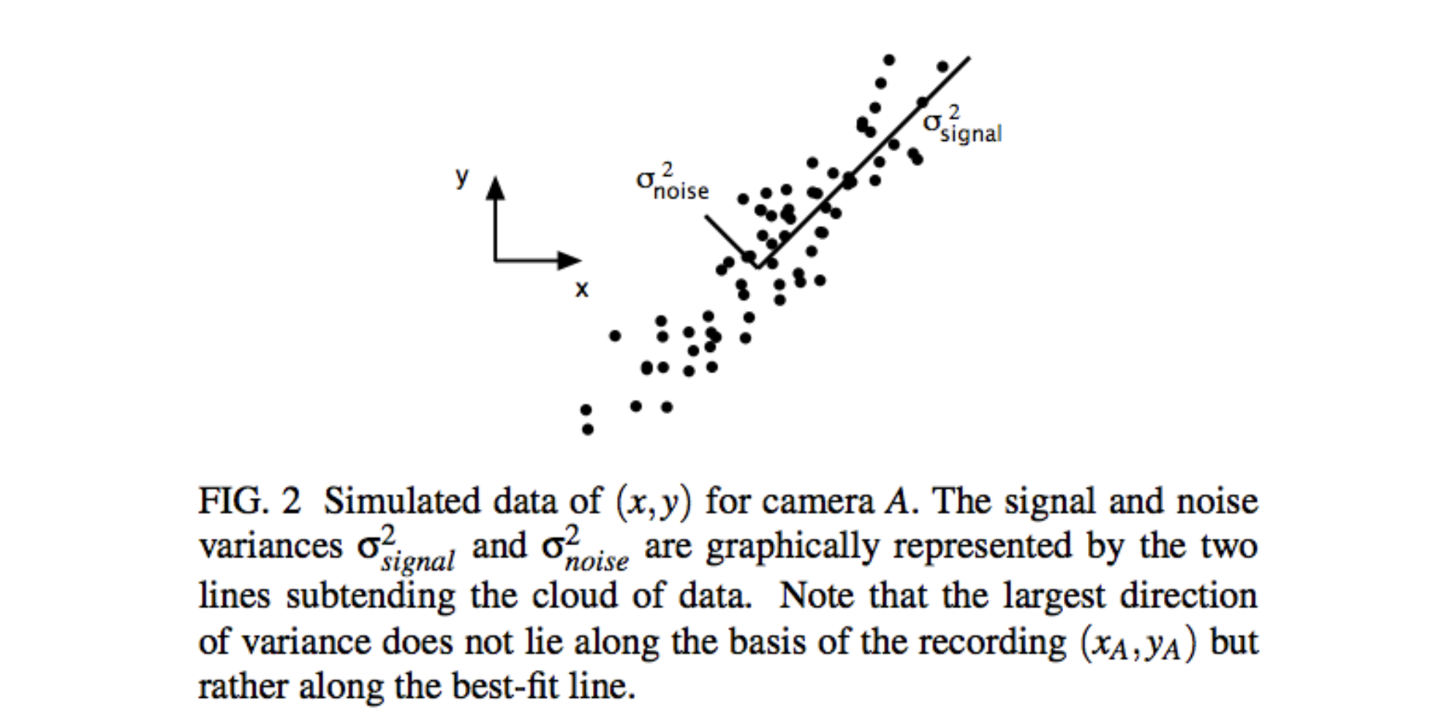
Principal component analysis

Slide 24
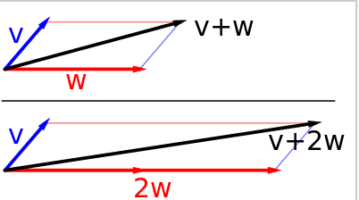
Stats basics
Important terms
Variance – How much a variable might change
Covariance – How two variables change together
Vector – A line
Matrix – A data structure with rows and columns
Matrices can also be though of as transformations – when you multiply a vector and a matrix, you get a back a vector in a different direction
Eigenvector – A vector that when multiplied by a matrix, doesn’t change directions

Slide 25
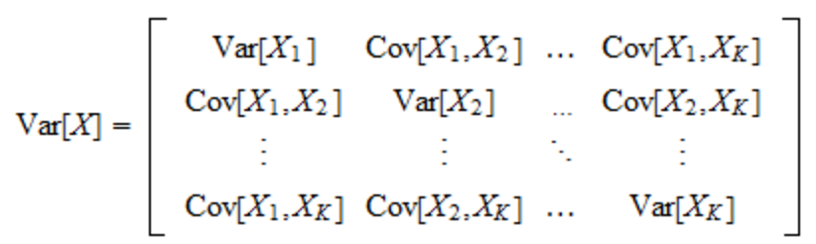
Principal component analysis
PCA
First computes the covariance matrix. This a matrix which holds information about each variables variance, and the covariance of one variable with another
Next compute the eigenvectors of the covariance matrix. The most important eigenvectors are the best ones to use for dimensionality reduction

Slide 26
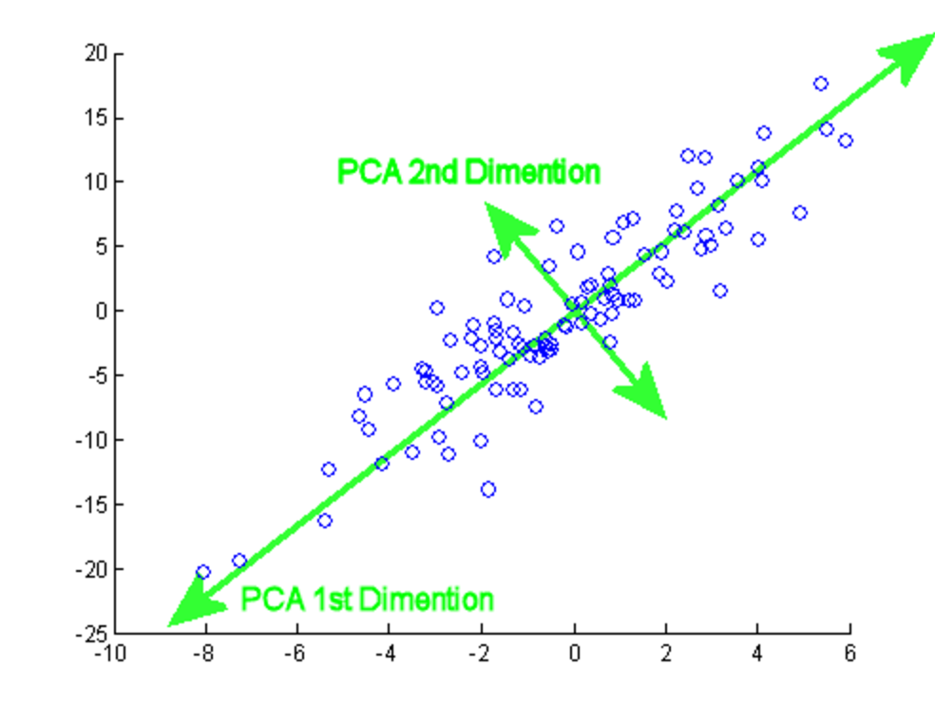
Principal component analysis
Principal components are the eigenvectors of the covariance matrix
They describe how the data changes the most

Slide 27
Principal component analysis
Principal components are the eigenvectors of the covariance matrix
They describe how the data changes the most

Slide 28
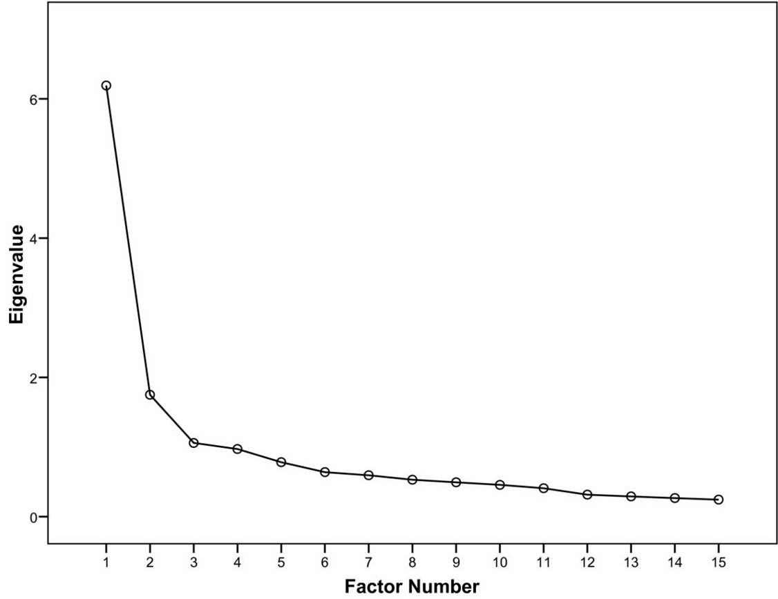
Principal component analysis
How many principal components do you need? Use a scree plot

Slide 29
Principal component analysis
How many principal components do you need? Use a scree plot

